Slide 1

A
Project Report
on
University Student Management System
Developed by
MODH DISHANT(IT-070) - Department of IT, DD University
JAY PANCHAL(IT-079) - Department of IT, DD University
Guided By
Internal Guide:
Prof. Archana N. Vyas
Prof. Vidhi Chaudhari
Department of Information Technology
Faculty of Technology
DD University
Department of Information Technology Faculty of Technology, Dharmsinh Desai University College Road, Nadiad-387001
October-2020
DHARMSINH DESAI UNIVERSITY

Slide 2
DHARMSINH DESAI UNIVERSITY NADIAD-387001, GUJARAT
CERTIFICATE
This is to certify that the project entitled “Foundation Management System” is a bonafied report of the work carried out by 1) Jay H. Panchal , Student ID No : 18ITUBS003
2) Dishant Modh, Student ID No : 18ITUBN116 of Department of Information Technology, semester V, under the guidance and supervision for the subject Database Management System. They were involved in Project training during academic year 2020-2021.
Prof. Vidhi B. Chaudhari
(Project Guide)
Department of Information Technology, Faculty of Technology,
Dharmsinh Desai University, Nadiad Date:
Prof. Vipul Dabhi
Head,
Department of Information Technology,
Faculty of Technology,
Dharmsinh Desai University, Nadiad Date:

Slide 3
ACKNOWLEDGEMENT
We would like to give our sincere acknowledgement to everybody responsible for the successful completion of our project “UNIVERSITY STUDENT MANAGEMENT SYSTEM”
The success and final outcome of this project required a lot of guidance and assistance from many people and we are extremely privileged to have got this all along the completion of this project.
We owe our deep gratitude to our project guide Prof. Roshni M. Raval, who took been interest on our project work and guided us all along till the completion of our project work by providing all the necessary help for developing a good Database System.
We would also like to thank all our lecturers.
Finally we convoy our acknowledgement to all our friends and family members who directly or indirectly associated with us in the successful completion of the project.We thank one and all.

Slide 4
1.Table of contents
I. Certificate……………………………………………………………………………………2
II. Acknowledgement………………………………………………………………………….3
1. SYSTEM OVERVIEW…………………………………………………………………….6
1.1 Current system…………………………………………………………………...6
1.2 Objectives of the Proposed System………………………………………………7
1.3 Advantages of the Proposed system (over current) ………………………………7
2. E-R DIAGRAM……………………………………………………………………………...8
3. DATA DICTIONARY……………………………………………………………………….
4. SCHEMA DIAGRAM……………………………………………………………………….
5. DATABASE IMPLEMENTION……………………………………………………………
5.1 Create Schema……………………………………………………………………
5.2 Insert Data values…………………………………………………………………
5.3 Queries (Based on functions, group by, having, joins, sub query etc.)……………
5.4 PL/SQL Blocks (Procedures and Exception Handling) ……………………………

Slide 5
5.5 Functions …………………………………………………………….
5.6 Cursors………………………………………………………………..
5.7 Trigger…………………………………………………………………
6. FUTURE ENHANCEMENTS OF THE SYSTEM……………………………………..
7. BIBLIOGRAPHY…………………………………………………………………..

Slide 6
1.SYSTEM OVERVIEW
1.1 CURRENT SYSTEM
University Student Management System is engineered to effectively administer every aspect of a University\College Student problem which they face while entering into new University\College at any unknown place.
Any Student who enters into new University/College they face some basic and huge problem like Finding PG\Hostel, Senior Contact for some notes, College Book’s for reading or if they want to buy them, and also for eating it will show restaurants.
It will also show the different type of Activity organised by his/her particular University/College and it also show the different Event’s occurring in his/her University/College.

Slide 7
1.2 OBJECTIVES OF THE PROPOSED SYSTEM
Students can easily find Broker’s for their Living, can easily get information for nearby restaurant for their Eating.
Getting contact of their Senior form which, they can get help.
They can contact their Activity Head easily.
1.3 ADVANTAGES OF STUDENT MANAGEMENT SYSTEM
Through this system we try to achieve the below objectives
To help students by providing study material from their seniors
Students can know all the available restaurants and caters for their breakfast, lunch and dinner.
Students can explore their interest by doing activities
Students can find rent house or hostel easily.
Students can also get their second-hand study material help easily.
Also, they find Stationery and Xerox stuff easily.
By using this system students can easily figure out which stationary or restaurants or Hostels are good for them, facility wise as well as price wise.

Slide 8
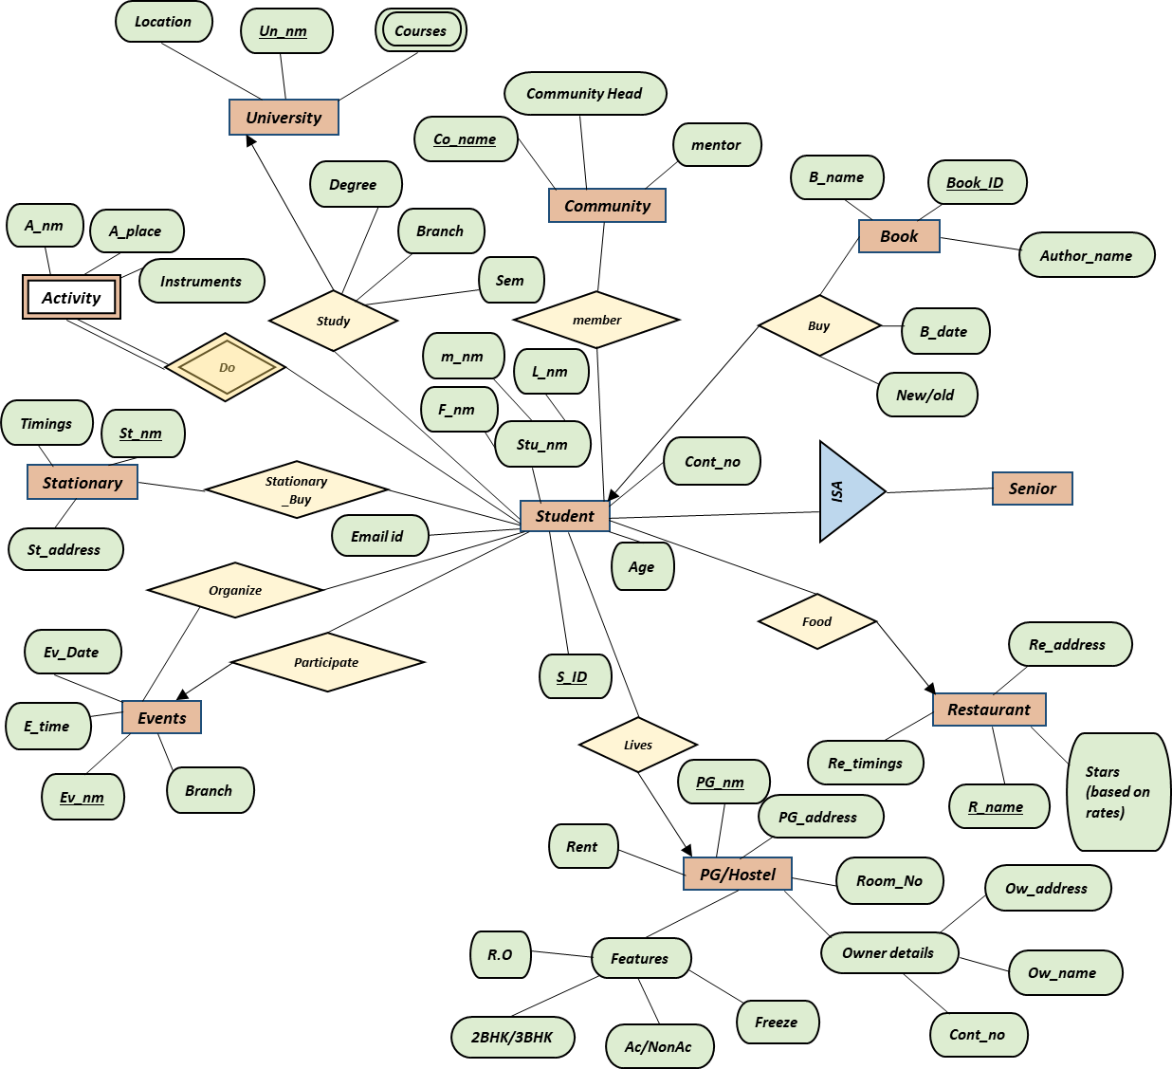
*
Manage
*
2.ER DIAGRAM
Manage
*
*
*
Manage
1
*
*
*
1
*
*
*
*
*
Manage
Username
Manage
*
*
*
*
*
Admin
*
*
*
Help
*
Manage
Password
*
*
*
*
*
1
*
Manage
1
Manage
*
*
*
*
1
Manage
*

Slide 9
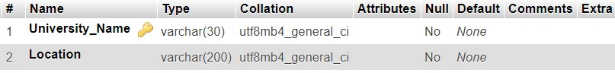
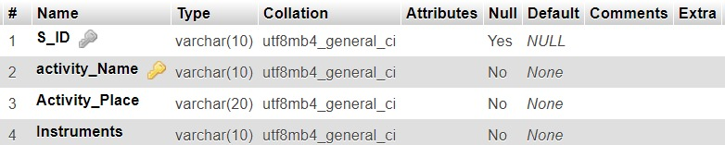
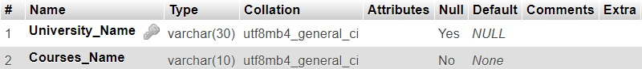
3. REALATIONAL
DATA
BASE
1. University
2. Activity
3. Courses

Slide 10
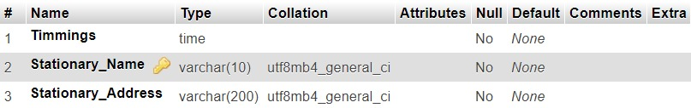
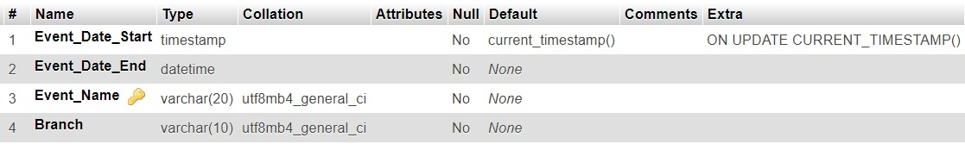
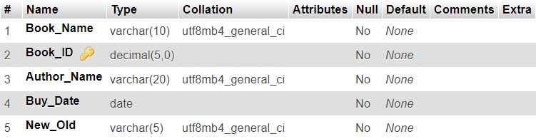
4. STATIONARY
5. EVENTS
6. BOOK

Slide 11
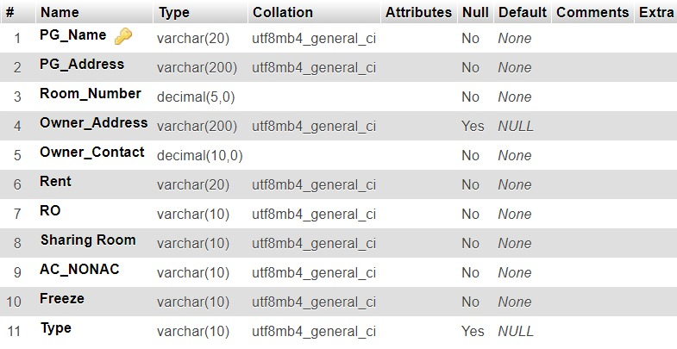
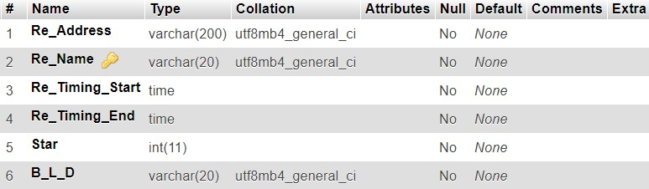
7. PG/HOSTEL
8. Restaurant

Slide 12
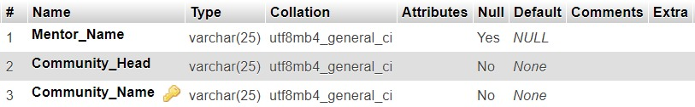
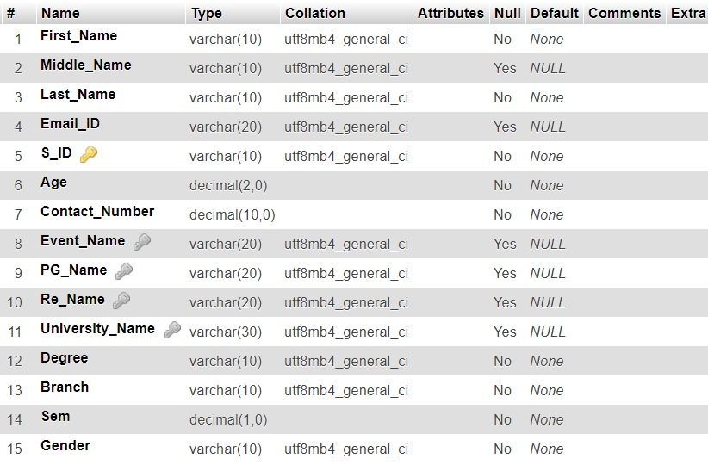
9. COMMUNITY
10. STUDENT

Slide 13
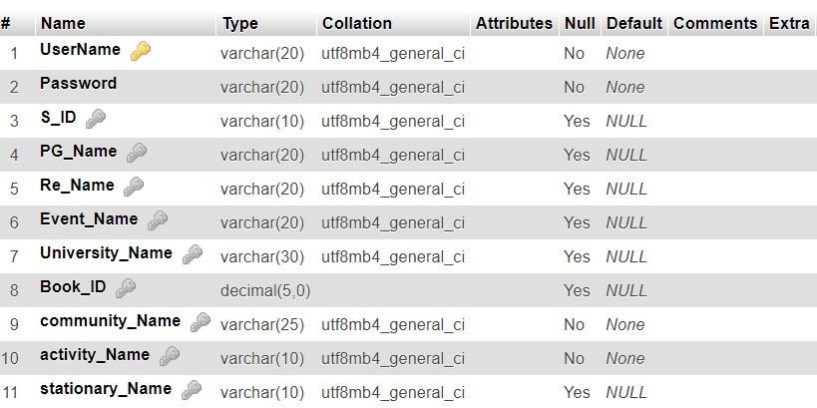
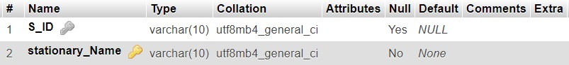
11. ADMIN
12. STATIONARY_BUY

Slide 14
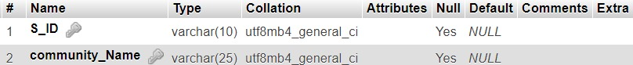
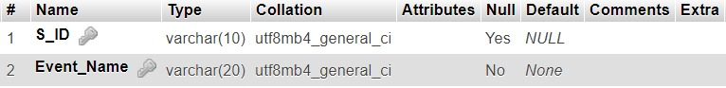
13. MEMBER
14. ORGANIZE

Slide 15
5.DATABASE IMPLEMENTATION
5.1 CREATE SCHEMA
5.1.1 STUDENT
CREATE TABLE STUDENT (First_Name VARCHAR(10) NOT NULL, Middle_Name VARCHAR(10) DEFAULT NULL, Last_Name VARCHAR(10) NOT NULL, Email_ID VARCHAR(20) DEFAULT NULL, S_ID VARCHAR(10) PRIMARY KEY, Age DECIMAL(2) NOT NULL, Contact_Number DECIMAL(10) NOT NULL, Event_Name VARCHAR(10), PG_Name VARCHAR(20), Re_Name VARCHAR(10), University_Name VARCHAR(30), Degree VARCHAR(10) NOT NULL, Branch VARCHAR(10) NOT NULL, Sem DECIMAL(1) NOT NULL);
ALTER TABLE `student` ADD CONSTRAINT `student1` FOREIGN KEY (`Event_Name`) REFERENCES `events` (`Event_Name`);
ALTER T)ABLE `student` ADD CONSTRAINT `student2` FOREIGN KEY (`PG_Name`) REFERENCES `pg_hostel` (`PG_Name`);
ALTER TABLE `student` ADD CONSTRAINT `student3` FOREIGN KEY (`Re_Name`) REFERENCES `resturant` (`Re_Name`);
ALTER TABLE `student` ADD CONSTRAINT `student4` FOREIGN KEY (`University_Name`) REFERENCES `university` (`University_Name`);
5.1.2 COMMUNITY
CREATE TABLE COMMUNITY (Mentor_Name VARCHAR(25) DEFAULT NULL, Community_Head VARCHAR(25) NOT NULL, Community_Name VARCHAR(25) PRIMARY KEY);

Slide 16
5.1.3 STATIONARY
CREATE TABLE STATIONARY (Timmings TIME NOT NULL, Stationary_Name VARCHAR(10) PRIMARY KEY, Stationary_Address VARCHAR(200) NOT NULL);
5.1.4 EVENT
CREATE TABLE EVENTS(Event_Date_Start TIMESTAMP NOT NULL, Event_Date_End DATETIME NOT NULL, Event_Name VARCHAR(20) PRIMARY KEY, Branch VARCHAR(10) NOT NULL);
5.1.5 BOOK
CREATE TABLE BOOK (Book_Name VARCHAR(10) NOT NULL, Book_ID DECIMAL(5) PRIMARY KEY, Author_Name VARCHAR(20) NOT NULL, Buy_Date DATE NOT NULL, New_Old VARCHAR(5) NOT NULL);

Slide 17
5.1.6 PG_HOSTEL
CREATE TABLE PG_HOSTEL (PG_Name VARCHAR(20) PRIMARY KEY, PG_Address varchar(200) NOT NULL, Room_Number DECIMAL(5) NOT NULL, Owner_Address VARCHAR(200) DEFAULT NULL, Owner_Contact DECIMAL(10) NOT NULL, Rent VARCHAR(20) NOT NULL, RO VARCHAR(10) NOT NULL, TWO_BHK_3BHK VARCHAR(10) NOT NULL, AC_NONAC VARCHAR(10) NOT NULL, Freeze VARCHAR(10) NOT NULL);
5.1.7 RESTURANT
CREATE TABLE Resturant (Re_Address VARCHAR(200) NOT NULL, Re_Name VARCHAR(20) PRIMARY KEY, Re_Timing_Start TIME NOT NULL, Re_Timing_End TIME NOT NULL, Star INT NOT NULL, B_L_D VARCHAR(20) NOT NULL);
5.1.8 ADMIN
CREATE TABLE ADMIN (UserName VARCHAR(20) PRIMARY KEY, Password VARCHAR(20) NOT NULL, S_ID VARCHAR(10), PG_Name VARCHAR(20), Re_Name VARCHAR(20), Event_Name VARCHAR(20), University_Name VARCHAR(10), Book_ID DECIMAL(5), community_Head VARCHAR(10) NOT NULL, Acitvity_Name VARCHAR(10) NOT NULL, stationary_Name VARCHAR(10))
ALTER TABLE `admin` ADD CONSTRAINT `amin1213` FOREIGN KEY (`stationary_Name`) REFERENCES `stationary` (`stationary_Name`)

Slide 18
5.1.9 ORGANIZE
CREATE TABLE Oraganize(S_ID VARCHAR(10), Event_Name VARCHAR(10) PRIMARY KEY)
5.1.10 STATIONARY_BUY
CREATE TABLE stationary_Buy (S_ID VARCHAR(10), stationary_Name VARCHAR(10) PRIMARY KEY)
ALTER TABLE `stationary_buy` ADD CONSTRAINT `sb` FOREIGN KEY (`S_ID`) REFERENCES `student` (`S_ID`)
5.1.11 MEMBER
CREATE TABLE member (S_ID VARCHAR(10),community_Name VARCHAR(25));
ALTER TABLE `member` ADD CONSTRAINT `m2` FOREIGN KEY (`S_ID`) REFERENCES `student` (`S_ID`);
ALTER TABLE `member` ADD CONSTRAINT `m3` FOREIGN KEY (`community_Name`) REFERENCES `community` (`community_Name`);

Slide 19
5.1.12 UNIVERSITY
CREATE TABLE University (University_Name VARCHAR(30) PRIMARY KEY, Location VARCHAR(200) NOT NULL)
5.1.13 COURSES
CREATE TABLE Courses (University_Name VARCHAR(30), Courses_Name VARCHAR(10) NOT NULL)
ALTER TABLE `courses` ADD CONSTRAINT `COURSES` FOREIGN KEY (`University_Name`) REFERENCES `university` (`University_Name`)
5.1.14 ACTIVITY
CREATE TABLE Activity (S_ID VARCHAR(10), Activity_Name VARCHAR(10) PRIMARY KEY, Activity_Place VARCHAR(20) NOT NULL, Instruments VARCHAR(10) NOT NULL)

Slide 20
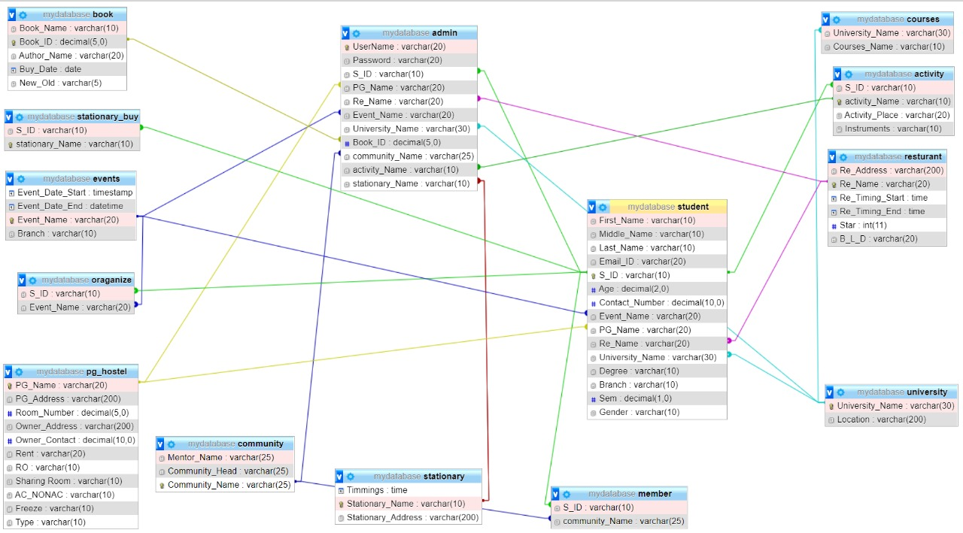

Slide 21
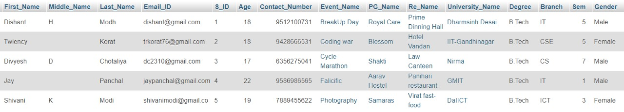
5.DATABASE IMPLEMENTATION
5.2 INSERT DATA VALUE
5.2.1 STUDENT
INSERT INTO `student`(`First_Name`, `Middle_Name`, `Last_Name`, `Email_ID`, `S_ID`, `Age`, `Contact_Number`, `Event_Name`, `PG_Name`, `Re_Name`, `University_Name`, `Degree`, `Branch`, `Sem`) VALUES ('Dishant','H','Modh','dishant@gmail.com','1', 18, 9512100731,'BreakUp Day','Royal Care','Prime Dinning Hall','Dharmsinh Desai','B.Tech','IT',5,’Male’ );
INSERT INTO `student`VALUES ('Twiency','','Korat','trkorat76@gmail.com','2', 18, 9428666531,'Coding war','Blossom','Hotel Vandan','IIT-Gandhinagar','B.Tech','CSE',5,'Female');
INSERT INTO `student`VALUES ('Divyesh','D','Chotaliya','dc2310@gmail.com','3', 17, 6356275041,'Cycle Marathon','Shakti','Law Canteen','Nirma','B.Tech','CS',7,'Male' );
INSERT INTO `student` VALUES ('Jay','','Panchal','jaypanchal@gmail.com','4', 22, 9586986565,'Falicific','Aarav Hostel','Panihari restaurant','GMIT','B.Tech','IT',1 ,'Male');
INSERT INTO `student`VALUES ('Shivani','K','Modi','shivanimodi@gmail.com','5', 19, 7889455622,'Photography','Samaras','Virat fast-food','DaIICT','B.Tech','ICT',3,'Female' );

Slide 22
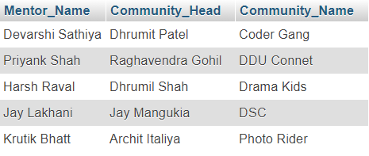
5.2.2 COMMUNITY
INSERT INTO `community`(`Mentor_Name`, `Community_Head`, `Community_Name`) VALUES ('Harsh Raval', 'Dhrumil Shah', 'Drama Kids');
INSERT INTO `community`(`Mentor_Name`, `Community_Head`, `Community_Name`) VALUES ('Devarshi Sathiya', 'Dhrumit Patel', 'Coder Gang');
INSERT INTO `community`(`Mentor_Name`, `Community_Head`, `Community_Name`) VALUES ('Priyank Shah', 'Raghavendra Gohil', 'DDU Connet');
INSERT INTO `community`(`Mentor_Name`, `Community_Head`, `Community_Name`) VALUES ('Krutik Bhatt', 'Archit Italiya', 'Photo Rider');
INSERT INTO `community`(`Mentor_Name`, `Community_Head`, `Community_Name`) VALUES ('Jay Lakhani', 'Jay Mangukia', 'DSC');

Slide 23
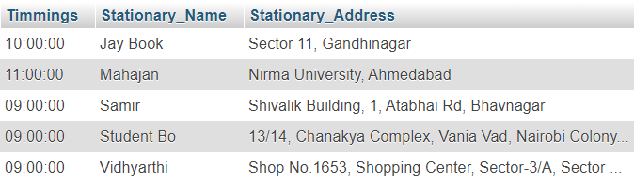
5.2.3 STATIONARY
INSERT INTO `stationary`(`Timmings`, `Stationary_Name`, `Stationary_Address`) VALUES ('09:00:00','Samir','Shivalik Building, 1, Atabhai Rd, Bhavnagar');
INSERT INTO `stationary`(`Timmings`, `Stationary_Name`, `Stationary_Address`) VALUES ('11:00:00','Mahajan','Nirma University, Ahmedabad');
INSERT INTO `stationary`(`Timmings`, `Stationary_Name`, `Stationary_Address`) VALUES ('09:00:00','Vidhyarthi','Shop No.1653, Shopping Center, Sector-3/A, Sector 3, Gandhinagar');
INSERT INTO `stationary`(`Timmings`, `Stationary_Name`, `Stationary_Address`) VALUES ('10:00:00','Jay Book ',' Sector 11, Gandhinagar');
INSERT INTO `stationary`(`Timmings`, `Stationary_Name`, `Stationary_Address`) VALUES ('09:00:00','Student Book','13/14, Chanakya Complex, Vania Vad, Nairobi Colony, Nadiad');

Slide 24
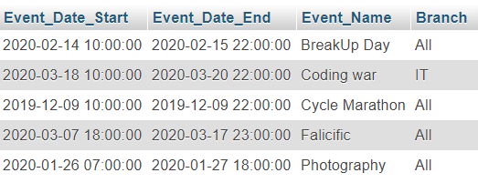
5.2.4 EVENTS
INSERT INTO `events`(`Event_Date_Start`, `Event_Date_End`, `Event_Name`, `Branch`) VALUES ('2019-12-09 10:00:00','2019-12-09 22:00:00','Cycle Marathon','All');
INSERT INTO `events`(`Event_Date_Start`, `Event_Date_End`, `Event_Name`, `Branch`) VALUES ('2020-01-26 07:00:00','2020-01-27 18:00:00','Photography','All');
INSERT INTO `events`(`Event_Date_Start`, `Event_Date_End`, `Event_Name`, `Branch`) VALUES ('2020-02-14 10:00:00','2020-02-15 22:00:00','BreakUp Day','All');
INSERT INTO `events`(`Event_Date_Start`, `Event_Date_End`, `Event_Name`, `Branch`) VALUES ('2020-03-07 18:00:00','2020-03-17 23:00:00','Falicific','All');
INSERT INTO `events`(`Event_Date_Start`, `Event_Date_End`, `Event_Name`, `Branch`) VALUES ('2020-03-18 10:00:00','2020-03-20 22:00:00','Coding war','IT');

Slide 25
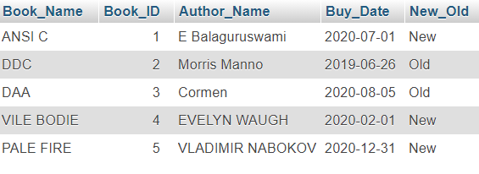
5.2.5 BOOK
INSERT INTO `book`(`Book_Name`, `Book_ID`, `Author_Name`, `Buy_Date`, `New_Old`) VALUES ('ANSI C', 1 , 'E Balaguruswami', '2020-07-01', 'New');
INSERT INTO `book`(`Book_Name`, `Book_ID`, `Author_Name`, `Buy_Date`, `New_Old`) VALUES ('DDC', 2 , 'Morris Manno', '2019-06-26', 'Old');
INSERT INTO `book`(`Book_Name`, `Book_ID`, `Author_Name`, `Buy_Date`, `New_Old`) VALUES ('DAA', 3 , 'Cormen', '2020-08-05','Old');
INSERT INTO `book`(`Book_Name`, `Book_ID`, `Author_Name`, `Buy_Date`, `New_Old`) VALUES ('VILE BODIES', 4 , 'EVELYN WAUGH', '2020-02-01', 'New');
INSERT INTO `book`(`Book_Name`, `Book_ID`, `Author_Name`, `Buy_Date`, `New_Old`) VALUES ('PALE FIRE', 5 , 'VLADIMIR NABOKOV', '2020-12-31', 'New');

Slide 26
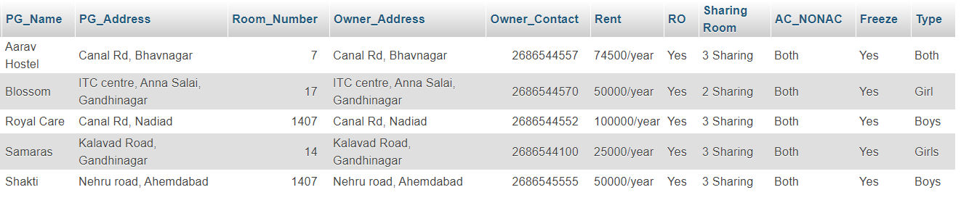
5.2.6 PG_HOSTEL
INSERT INTO `pg_hostel` VALUES ('Royal Care','Canal Rd, Nadiad', 1407, 'Canal Rd, Nadiad', 02686544552, '100000/year' , 'Yes','3 Sharing','Both','Yes','Boys');
INSERT INTO `pg_hostel` VALUES ('Aarav Hostel','Canal Rd, Bhavnagar', 7, 'Canal Rd, Bhavnagar', 02686544557, '74500/year' , 'Yes','3 Sharing','Both','Yes','Both');
INSERT INTO `pg_hostel` VALUES ('Blossom','ITC centre, Anna Salai, Gandhinagar', 17, 'ITC centre, Anna Salai, Gandhinagar', 02686544570, '50000/year' , 'Yes','2 Sharing','Both','Yes','Girl');
INSERT INTO `pg_hostel` VALUES ('Samaras','Kalavad Road, Gandhinagar', 14, 'Kalavad Road, Gandhinagar', 02686544100, '25000/year' , 'Yes','3 Sharing','Both','Yes','Girls');
INSERT INTO `pg_hostel` VALUES ('Shakti','Nehru road, Ahemdabad', 1407, 'Nehru road, Ahemdabad', 02686545555, '50000/year' , 'Yes','3 Sharing','Both','Yes','Boys');

Slide 27
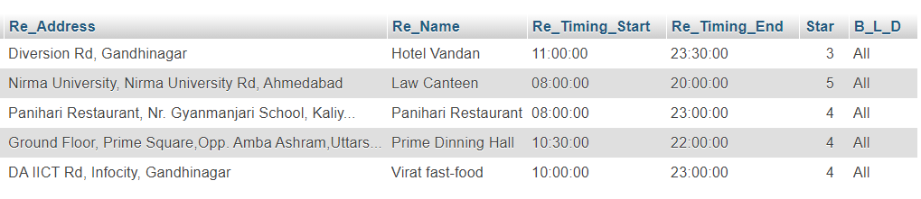
5.2.7 RESTURANT
INSERT INTO `resturant`(`Re_Address`, `Re_Name`, `Re_Timing_Start`, `Re_Timing_End`, `Star`, `B_L_D`) VALUES ('Ground Floor, Prime Square,Opp. Amba Ashram,Uttarsanda Road, near DDIT College, Nadiad','Prime Dinning Hall','10:30:00','22:00:00', 4, 'All');
INSERT INTO `resturant`(`Re_Address`, `Re_Name`, `Re_Timing_Start`, `Re_Timing_End`, `Star`, `B_L_D`) VALUES ('DA IICT Rd, Infocity, Gandhinagar','Virat fast-food','10:00:00','23:00:00', 4 , 'All');
INSERT INTO `resturant`(`Re_Address`, `Re_Name`, `Re_Timing_Start`, `Re_Timing_End`, `Star`, `B_L_D`) VALUES ('Diversion Rd, Gandhinagar','Hotel Vandan','11:00:00','23:30:00', 3, 'All');
INSERT INTO `resturant`(`Re_Address`, `Re_Name`, `Re_Timing_Start`, `Re_Timing_End`, `Star`, `B_L_D`) VALUES ('Nirma University, Nirma University Rd, Ahmedabad','Law Canteen','08:00:00','20:00:00', 4.5, 'All');
INSERT INTO `resturant`(`Re_Address`, `Re_Name`, `Re_Timing_Start`, `Re_Timing_End`, `Star`, `B_L_D`) VALUES ('Panihari Restaurant, Nr. Gyanmanjari School, Kaliyabid, Bhavnagar','Panihari Restaurant','08:00:00','23:00:00', 4, 'All');

Slide 28
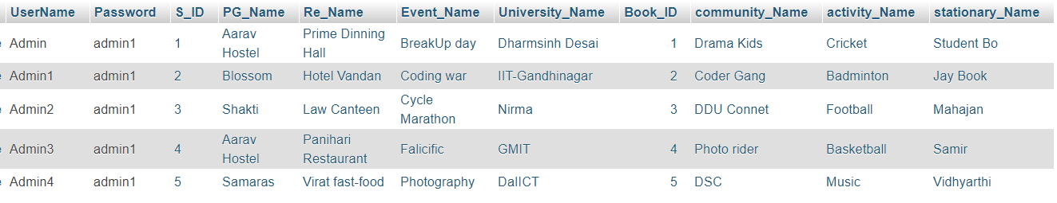
5.2.8 ADMIN
INSERT INTO `admin`(`UserName`, `Password`, `S_ID`, `PG_Name`, `Re_Name`, `Event_Name`, `University_Name`, `Book_ID`, `community_Name`, `activity_Name`, `stationary_Name`) VALUES ('Admin', 'admin1','1','Aarav Hostel','Prime Dinning Hall','BreakUp day','Dharmsinh Desai','1','Drama Kids','Cricket','Student Bo');
INSERT INTO `admin`(`UserName`, `Password`, `S_ID`, `PG_Name`, `Re_Name`, `Event_Name`, `University_Name`, `Book_ID`, `community_Name`, `activity_Name`, `stationary_Name`) VALUES ('Admin1', 'admin1','2','Blossom','Hotel Vandan','Coding war','IIT-Gandhinagar','2','Coder Gang','Badminton','Jay Book');
INSERT INTO `admin`(`UserName`, `Password`, `S_ID`, `PG_Name`, `Re_Name`, `Event_Name`, `University_Name`, `Book_ID`, `community_Name`, `activity_Name`, `stationary_Name`) VALUES ('Admin2', 'admin1','3','Shakti','Law Canteen','Cycle Marathon','Nirma','3','DDU Connet','Football','Mahajan');
INSERT INTO `admin`(`UserName`, `Password`, `S_ID`, `PG_Name`, `Re_Name`, `Event_Name`, `University_Name`, `Book_ID`, `community_Name`, `activity_Name`, `stationary_Name`) VALUES ('Admin3', 'admin1','4','Aarav Hostel','Panihari Restaurant','Falicific','GMIT','4','Photo rider','Basketball','Samir');
INSERT INTO `admin`(`UserName`, `Password`, `S_ID`, `PG_Name`, `Re_Name`, `Event_Name`, `University_Name`, `Book_ID`, `community_Name`, `activity_Name`, `stationary_Name`) VALUES ('Admin4', 'admin1','5','Samaras','Virat fast-food','Photography','DaIICT','5','DSC','Music','Vidhyarthi');

Slide 29
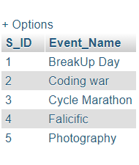
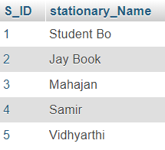
5.2.9 ORGANIZE
INSERT INTO `member`(`S_ID`, `Event_Name`) VALUES ('1','BreakUp Day');
INSERT INTO `member`(`S_ID`, `Event_Name`) VALUES ('2','Coding war');
INSERT INTO `member`(`S_ID`, `Event_Name`) VALUES ('3','Cycle Marathon');
INSERT INTO `member`(`S_ID`, `Event_Name`) VALUES ('4','Falicicfic');
INSERT INTO `member`(`S_ID`, `Event_Name`) VALUES ('5','Photography');
5.2.10 STATIONARY_BUY
INSERT INTO `stationary_buy`(`S_ID`, `stationary_Name`) VALUES (‘1’,’Student Bo’);
INSERT INTO `stationary_buy`(`S_ID`, `stationary_Name`) VALUES (‘2’, ‘Jay Book’);
INSERT INTO `stationary_buy`(`S_ID`, `stationary_Name`) VALUES (‘3’,’Mahajan’);
INSERT INTO `stationary_buy`(`S_ID`, `stationary_Name`) VALUES (‘4’,’Samir’);
INSERT INTO `stationary_buy`(`S_ID`, `stationary_Name`) VALUES (‘5’,’Vidhyarthi’);

Slide 30
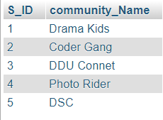
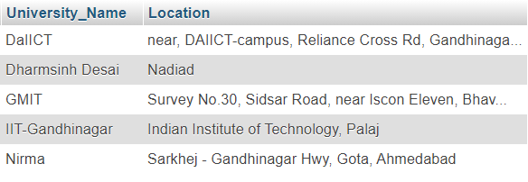
5.2.11 MEMBER
INSERT INTO `member`(`S_ID`, `community_Name`) VALUES ('1','Drama Kids');
INSERT INTO `member`(`S_ID`, `community_Name`) VALUES ('2','Coder Gang');
INSERT INTO `member`(`S_ID`, `community_Name`) VALUES ('3','DDU Connet');
INSERT INTO `member`(`S_ID`, `community_Name`) VALUES ('4','Photo Rider');
INSERT INTO `member`(`S_ID`, `community_Name`) VALUES ('5','DSC');
5.2.12 UNIVERSITY
INSERT INTO `university`(`University_Name`, `Location`) VALUES ('Dharmsinh Desai', 'Nadiad');
INSERT INTO `university`(`University_Name`, `Location`) VALUES ('GMIT', 'Survey No.30, Sidsar Road, near Iscon Eleven, Bhavnagar');
INSERT INTO `university`(`University_Name`, `Location`) VALUES ('DaIICT', 'near, DAIICT-campus, Reliance Cross Rd, Gandhinagar');
INSERT INTO `university`(`University_Name`, `Location`) VALUES ('Nirma', 'Sarkhej - Gandhinagar Hwy, Gota, Ahmedabad');
INSERT INTO `university`(`University_Name`, `Location`) VALUES ('IIT-Gandhinagar', ' Indian Institute of Technology, Palaj');

Slide 31
5.2.13 COURSES
INSERT INTO `courses`(`University_Name`, `Courses_Name`) VALUES ('DaIICT','ICT');
INSERT INTO `courses`(`University_Name`, `Courses_Name`) VALUES ('DaIICT','ICT-CS');
INSERT INTO `courses`(`University_Name`, `Courses_Name`) VALUES ('DaIICT','MnC');
INSERT INTO `courses`(`University_Name`, `Courses_Name`) VALUES ('Dharmsinh Desai','CH');
INSERT INTO `courses`(`University_Name`, `Courses_Name`) VALUES ('Dharmsinh Desai','CE');
INSERT INTO `courses`(`University_Name`, `Courses_Name`) VALUES ('Dharmsinh Desai','IT');
INSERT INTO `courses`(`University_Name`, `Courses_Name`) VALUES ('Dharmsinh Desai','MH');
INSERT INTO `courses`(`University_Name`, `Courses_Name`) VALUES ('Dharmsinh Desai','EC');
INSERT INTO `courses`(`University_Name`, `Courses_Name`) VALUES ('Dharmsinh Desai','IC');
INSERT INTO `courses`(`University_Name`, `Courses_Name`) VALUES ('Dharmsinh Desai','Civil');
INSERT INTO `courses`(`University_Name`, `Courses_Name`) VALUES ('Dharmsinh Desai','BCA');
INSERT INTO `courses`(`University_Name`, `Courses_Name`) VALUES ('Dharmsinh Desai','MBA');
INSERT INTO `courses`(`University_Name`, `Courses_Name`) VALUES ('Dharmsinh Desai','MCA');
INSERT INTO `courses`(`University_Name`, `Courses_Name`) VALUES ('Dharmsinh Desai','BDS');
INSERT INTO `courses`(`University_Name`, `Courses_Name`) VALUES ('Dharmsinh Desai','MBBS');
INSERT INTO `courses`(`University_Name`, `Courses_Name`) VALUES ('Nirma','CS');
INSERT INTO `courses`(`University_Name`, `Courses_Name`) VALUES ('Nirma','EC');
INSERT INTO `courses`(`University_Name`, `Courses_Name`) VALUES ('Nirma','CH');
INSERT INTO `courses`(`University_Name`, `Courses_Name`) VALUES ('GMIT','CE');

Slide 32
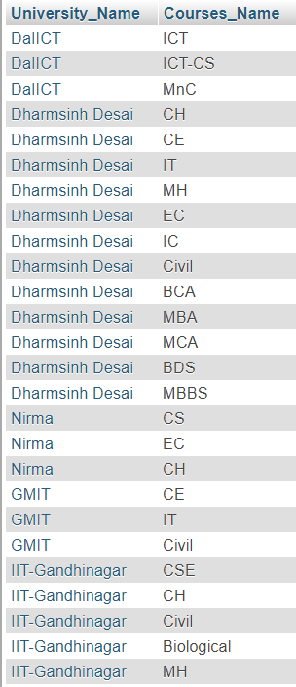
INSERT INTO `courses`(`University_Name`, `Courses_Name`) VALUES ('GMIT','IT');
INSERT INTO `courses`(`University_Name`, `Courses_Name`) VALUES ('GMIT','Civil');
INSERT INTO `courses`(`University_Name`, `Courses_Name`) VALUES ('IIT-Gandhinagar','CSE');
INSERT INTO `courses`(`University_Name`, `Courses_Name`) VALUES ('IIT-Gandhinagar','CH');
INSERT INTO `courses`(`University_Name`, `Courses_Name`) VALUES ('IIT-Gandhinagar','Civil');
INSERT INTO `courses`(`University_Name`, `Courses_Name`) VALUES ('IIT-Gandhinagar','Biological Engg.');
INSERT INTO `courses`(`University_Name`, `Courses_Name`) VALUES ('IIT-Gandhinagar','MH');

Slide 33
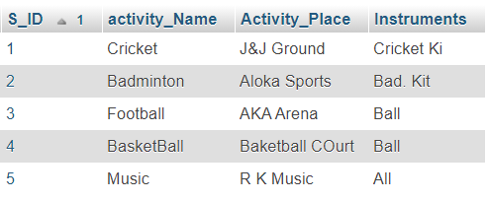
5.2.14 ACTIVITY
INSERT INTO `activity`(`S_ID`, `activity_Name`, `Activity_Place`, `Instruments`) VALUES ('1','Cricket','J&J Ground','');
INSERT INTO `activity`(`S_ID`, `activity_Name`, `Activity_Place`, `Instruments`) VALUES ('2','Badminton','Aloka Sports','Sitar');
INSERT INTO `activity`(`S_ID`, `activity_Name`, `Activity_Place`, `Instruments`) VALUES ('3','Football','AKA Arena','Guitar');
INSERT INTO `activity`(`S_ID`, `activity_Name`, `Activity_Place`, `Instruments`) VALUES ('4','BasketBall','Baketball COurt','');
INSERT INTO `activity`(`S_ID`, `activity_Name`, `Activity_Place`, `Instruments`) VALUES ('5','Music','RK Music','All');

Slide 34
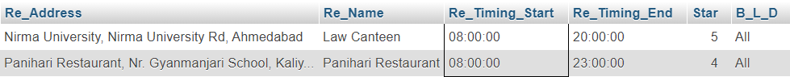
5.DATABASE IMPLEMENTATION
5.3 Queries
5.3.1 Give the name of the restaurant which start earliest at morning.
SELECT * FROM `resturant` WHERE `Re_Timing_Start`=(SELECT MIN(Re_Timing_Start) FROM `resturant`);

Slide 35
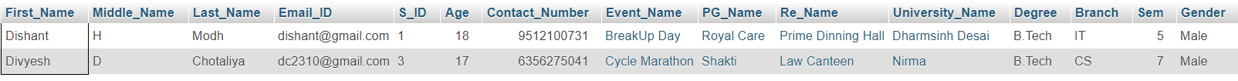
5.3.2 Find out the name of all the students having ‘D’ as the first letter in their names.
Select * from `student` where `First_Name` like `D%`;

Slide 36
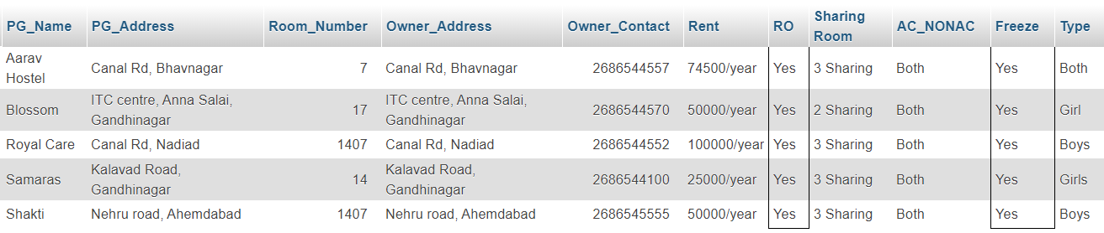
5.3.3 Display All The Information Of pg or hostel which has RO and Freeze both facilities.
SELECT * FROM `pg_hostel` WHERE `RO`='yes' AND `Freeze`='yes'

Slide 37
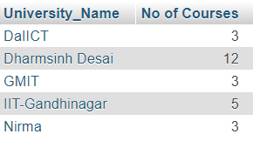
5.3.4 Display university name Along With Number Of courses In Each university In Decreasing Order.
SELECT `University_Name`,COUNT(`Courses_Name`) AS 'No of Courses' FROM `courses` GROUP BY `University_Name` ORDER BY 'No of Courses' DESC

Slide 38
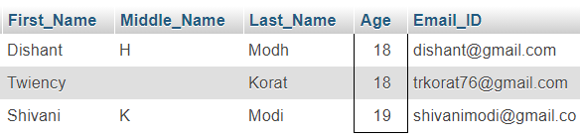
5.3.5 Display student full name and email id whose age is between 18 to 20.
SELECT `First_Name`, `Middle_Name`, `Last_Name`, `Age` , `Email_ID` FROM `student` WHERE `Age` BETWEEN 18 AND 20

Slide 39
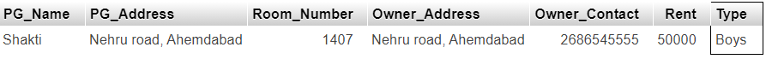
5.3.6 Give a Boys hostel name whose rent is less then 100000
SELECT `PG_Name`, `PG_Address`, `Room_Number`, `Owner_Address`, `Owner_Contact`, `Rent`, `Type` FROM (SELECT * FROM `pg_hostel` WHERE `Type`="Boys") WHERE rent<100000;

Slide 40
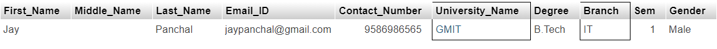
5.3.7 print name of the students who studies in GMIT from branch IT.
SELECT `First_Name`, `Middle_Name`, `Last_Name`, `Email_ID`,`Contact_Number`,`University_Name`, `Degree`, `Branch`, `Sem`, `Gender` FROM (SELECT * FROM `student` WHERE `Branch`="IT") WHERE `University_Name`="GMIT";

Slide 41
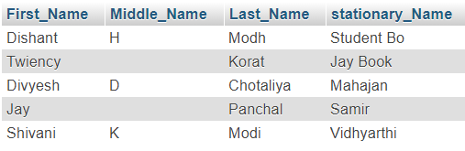
5.3.8 Print student name from where they buy stationary items
SELECT `First_Name`, `Middle_Name`, `Last_Name`, `stationary_Name` FROM `student` LEFT JOIN `stationary_buy` ON student.S_ID=stationary_buy.S_ID WHERE 1

Slide 42
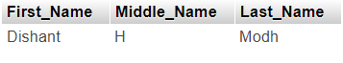
5.3.9 Print student name whose university is located in Nadiad.
SELECT `First_Name`,`Middle_Name`,`Last_Name` FROM `university` INNER JOIN `student` ON university.University_Name=student.University_Name WHERE `Location`="Nadiad"

Slide 43
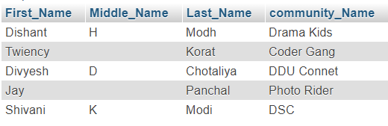
5.3.10 Give the name of the student along with their community name.
SELECT `First_Name`, `Middle_Name`, `Last_Name`,`community_Name` FROM `student` RIGHT JOIN `member` ON student.S_ID=member.S_ID WHERE 1

Slide 44
5.DATABASE IMPLEMENTATION
5.4 Procedures and Exception Handling
5.4.1 Insert Student Data After Checking All the Validation like email ID, Phone No.
DELIMITER $$
create procedure StuData(IN first_name varchar(10),IN middle_name varchar(10),IN last_name varchar(10),IN email_id varchar(20),IN age decimal(2,0),IN Contact_Number decimal(10,0),IN event_name varchar(20),IN pg_name varchar(20),IN re_name varchar(20),IN University_name varchar(30),IN degree varchar(10),IN branch varchar(10),IN sem decimal(1,0),IN gender varchar(10))
begin
DECLARE Counter varchar(4);
select count(s_id) into Counter from student;
set counter = counter + 1;
IF email_id like '%@gmail.com' THEN
IF length(contact_number) <=> 10 THEN
IF (select count(University_name) from University u where u.university_name = University_name) then
SELECT 'University Found' AS MESSAGE;
INSERT into student VALUES (first_name,middle_name,last_name,email_id,counter,age,contact_number,event_name,pg_name,re_name,University_name,degree,branch,sem,gender);
SELECT 'YOUR DATA IS INSERTED' AS MESSAGE;

Slide 45
ELSE
SELECT 'Enter Valid Name' AS ERROR;
END IF;
ELSE
SELECT 'Your Mobile No. is not valid' AS ERROR;
END IF;
ELSE
SELECT 'YOUR Email-ID is not valid' AS ERROR;
END IF;
END $$
DELIMITER ;

Slide 46
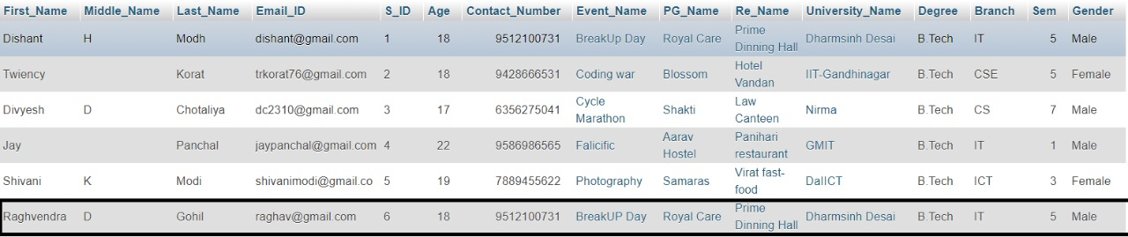
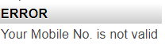
Call StuData('Raghvendra','D','Gohil','raghav@gmail.com',18,9512100731,'BreakUP Day','Royal Care','Prime Dinning Hall','Dharmsinh Desai','B.Tech','IT',5,'Male');
Call StuData('Raghvendra','D','Gohil','raghav@gmail.com',18,9512100,'BreakUP Day','Royal Care','Prime Dinning Hall','Dharmsinh Desai','B.Tech','IT',5,'Male');
→As from above query Number Format is not proper so, it will give ERROR.

Slide 47
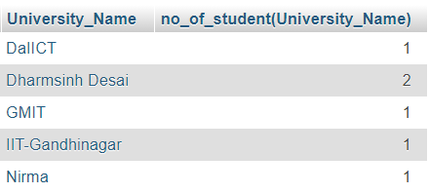
5.DATABASE IMPLEMENTATION
5.5 Functions
5.5.1 Show the number of Student in particular University.
DELIMITER $$
CREATE FUNCTION no_of_student(University_Name varchar(30)) RETURNS int DETERMINISTIC
BEGIN
DECLARE no int;
SELECT COUNT(S_ID) INTO no FROM student s WHERE s.University_Name=University_Name;
RETURN no;
END
$$
DELIMITER ;
SELECT University_Name, no_of_student(University_Name) FROM student GROUP BY University_Name;

Slide 48
5.6 Cursor
5.6.1 Show Name Of all Restaurant’s.
DELIMITER $$
CREATE PROCEDURE r1 (INOUT Name_List VARCHAR(1000))
BEGIN
DECLARE done INTEGER DEFAULT 0;
DECLARE r_name VARCHAR(20) DEFAULT "";
DECLARE r_cursor CURSOR FOR
SELECT Re_Name FROM resturant;
DECLARE CONTINUE HANDLER FOR NOT FOUND SET done = 1;
OPEN r_cursor;
list:LOOP
FETCH r_cursor INTO r_name;
IF done = 1 THEN
LEAVE list;
END IF;
SET Name_List = CONCAT(r_name, "-->",Name_List);
END LOOP list;
CLOSE r_cursor;
END$$
DELIMITER ;

Slide 49
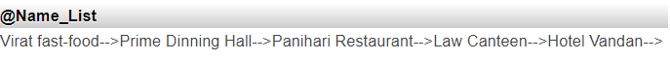
SET @Name_List="";
CALL r1(@Name_List);
SELECT @Name_List;

Slide 50
5.6 Trigger
5.6.1 Update Event name into Event table and Organize table using Trigger.
DELIMITER $$
CREATE TRIGGER e1 AFTER UPDATE ON events FOR EACH ROW
BEGIN
DECLARE v1 VARCHAR(20);
SELECT Event_Name INTO v1 FROM events WHERE Event_Name=NEW.Event_Name;
UPDATE `oraganize` SET `Event_Name`=v1 WHERE Event_Name=OLD.Event_Name;
END $$
DELIMITER ;
UPDATE `events` SET `Event_Name`="Dargon Ball" WHERE Event_Name="Coding war";

Slide 51
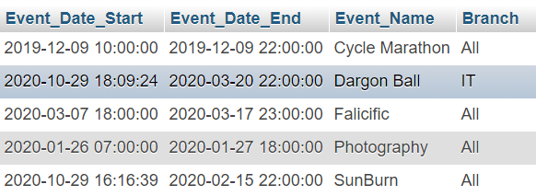
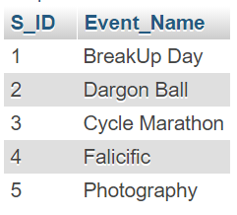
After Update on Event Table.
Updated by Trigger on Organize table.

Slide 52
5.6.2 Delete Community Name from Community Table and Member table using Trigger.
DELIMITER $$
CREATE TRIGGER c1 AFTER DELETE ON community FOR EACH ROW
BEGIN
DECLARE v1 VARCHAR(20);
SELECT Community_Name INTO v1 FROM community WHERE Community_Name_Name=NEW.Community_Name;
DELETE FROM `member` WHERE Community_Name=OLD.Community_Name;
END $$
DELIMITER ;
DELETE FROM `community` WHERE Community_Name="DSC";

Slide 53
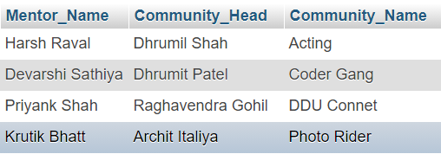
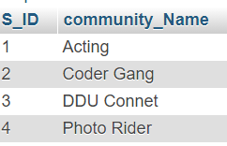
After Deleting “DSC” from community table
Deleted “DSC” from Member table using DELETE Trigger

Slide 54
6.Future enhancements of the system
We will design Front-end Design in HTML, CSS, JavaScript and Develop Bank-end in Python
For security purpose New Registration is done using OTP.
Outputs, methods and user data input will be lot easy after the implement of GUI.
We will make database more consistent and We are making this database efficient
and easy to implement with huge data capacity.
Methods and user data input will be lot easy after the implement of GUI.
We will also add some extra features so that the users can get answer for their complaints as fast as possible.

Slide 55
7.Bibliography
We created the ER Diagram and Schema Diagram on MySQL Tool.
Reference book:
Data Base System Concepts
-Henry F. Korth & A. Silberschatz 2nd Ed. McGraw-Hill 1991
Reference Book:
https://www.mysqltutorial.org/

